Slide 1

Vel Tech Rangarajan Dr. Sagunthala R&D Institute of Science and Technology
School of Computing
Department of Computer Science and Engineering
10211CS224 / FULL STACK APPLICATION DEVELOPMENT (JAVA)
PROJECT REVIEW : MILESTONE PROJECT – 2
Date:22-04-2026
EventSphere: Smart College Event Platform
SDG:4 – Quality Education
Presented By:
CH.VENNELA REDDY– VTU25619– Reg.No.23UECS0956
Courses Handling Faculty:
Dr.S.Hemamalini,M.E,Ph.D.

Slide 2
INTRODUCTION
1
EventSphere is a web-based platform designed to simplify and digitize college event management.
It integrates all processes like event registration, payment, attendance tracking, and certificate generation into one system.
The platform includes two modules: Student Portal for users and Admin Portal for event organizers.
Students can view events, register online, and make secure payments through the platform.
Admins can create/manage events, monitor registrations, and track payments in real time.
Attendance is marked by the admin, and only students who are present are considered valid participants.
The system provides automatic certificate generation, allowing eligible students to download their certificates instantly.
2
3
4
5
6
7
8
9

Slide 3
PROBLEM STATEMENT
In many colleges, event management is handled manually or through separate systems, causing inefficiency and errors. Registration, payment tracking, attendance marking, and certificate distribution are often unorganized and time-consuming. There is no proper system to ensure that only students who attend events receive certificates. Hence, a centralized platform is needed to automate and streamline the entire process efficiently.
1
2
3
4
5
6
7
8
9

Slide 4
OBJECTIVE(S)
1
To develop a centralized platform for managing all college event activities in one place.
To enable easy online event registration and secure payment processing for students.
To provide an efficient system for real-time attendance tracking by the admin.
To automate certificate generation and distribution for students who attend the events.
2
3
4
5
6
7
8
9

Slide 5
PROPOSED SYSTEM
EventSphere is a centralized web-based platform for managing college events efficiently.
It integrates key functionalities such as event creation, registration, payment, attendance tracking, and certificate generation into one system.
The system provides two modules:
Student Portal for browsing events, registration, and payment
Admin Portal for managing events and monitoring activities
Students can register for events and make secure online payments through the platform.
Admins can create events, track registrations, and manage payments in real time.
Digital attendance marking is done by the admin during the event to ensure accuracy.
The system enables automatic certificate generation, allowing only eligible (present) students to download their certificates
1
2
3
4
5
6
7
8
9

Slide 6
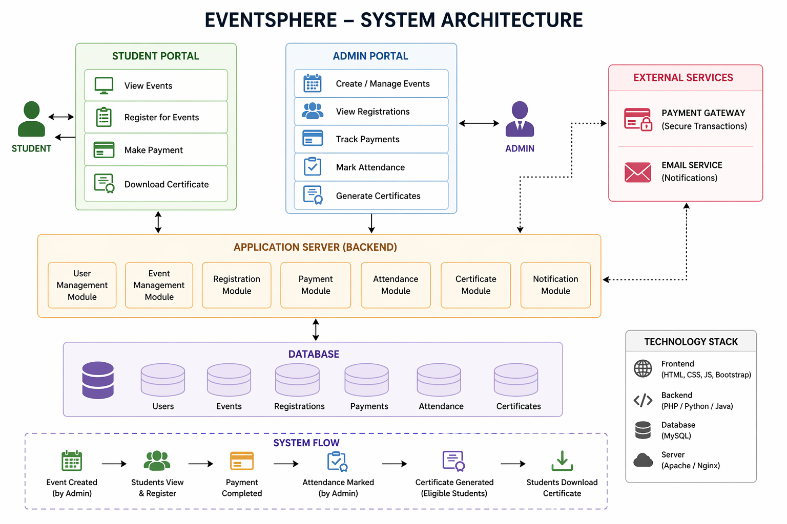
PROPOSED SYSTEM ARCHITECTURE
1
2
3
4
5
6
7
8
9

Slide 7
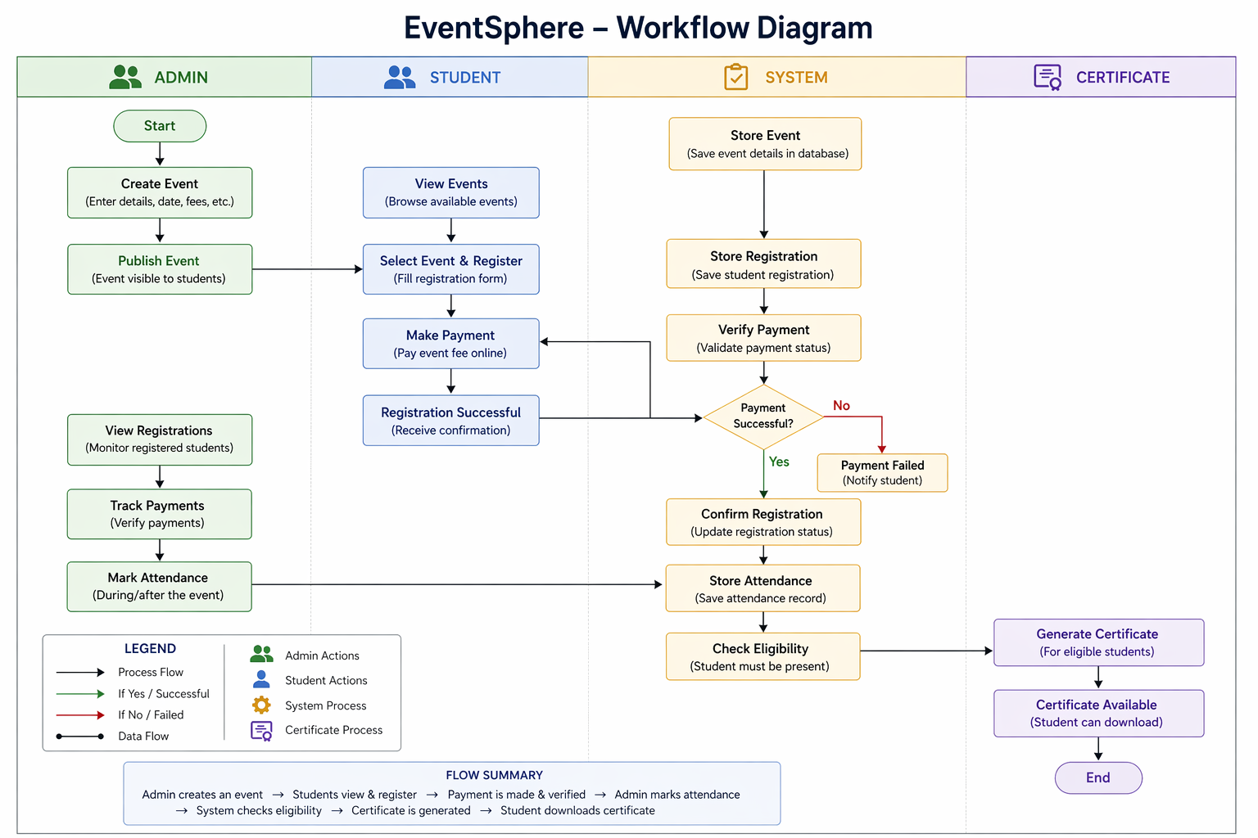
WORKFLOW
1
2
3
4
5
6
7
8
9

Slide 8
TECHNOLOGIES USED
Frontend: React JS, HTML, CSS
Backend: PHP
Database: MySQL
Tools: XAMPP, VS Code, phpMyAdmin
Hardware/Software Requirements: A laptop with minimum 4GB RAM, web browser (Chrome/Edge), XAMPP server installed
1
2
3
4
5
6
7
8
9

Slide 9
MODULE DESCRIPTION
Student Module: Allows students to view available events, register for events, make online payments, and download certificates after successful participation.
Admin Module: Enables admin to create and manage events, monitor registrations, verify payments, and mark student attendance.
Event Management Module: Handles creation, updating, and deletion of events along with event details like date, time, and fees.
Registration & Payment Module: Manages student registrations and processes secure payments while maintaining transaction records.
Attendance Module: Allows admin to mark and store attendance of students during the event.
Certificate Generation Module: Automatically generates certificates for students who are marked present and makes them available for download.
1
2
3
4
5
6
7
8
9

Slide 10
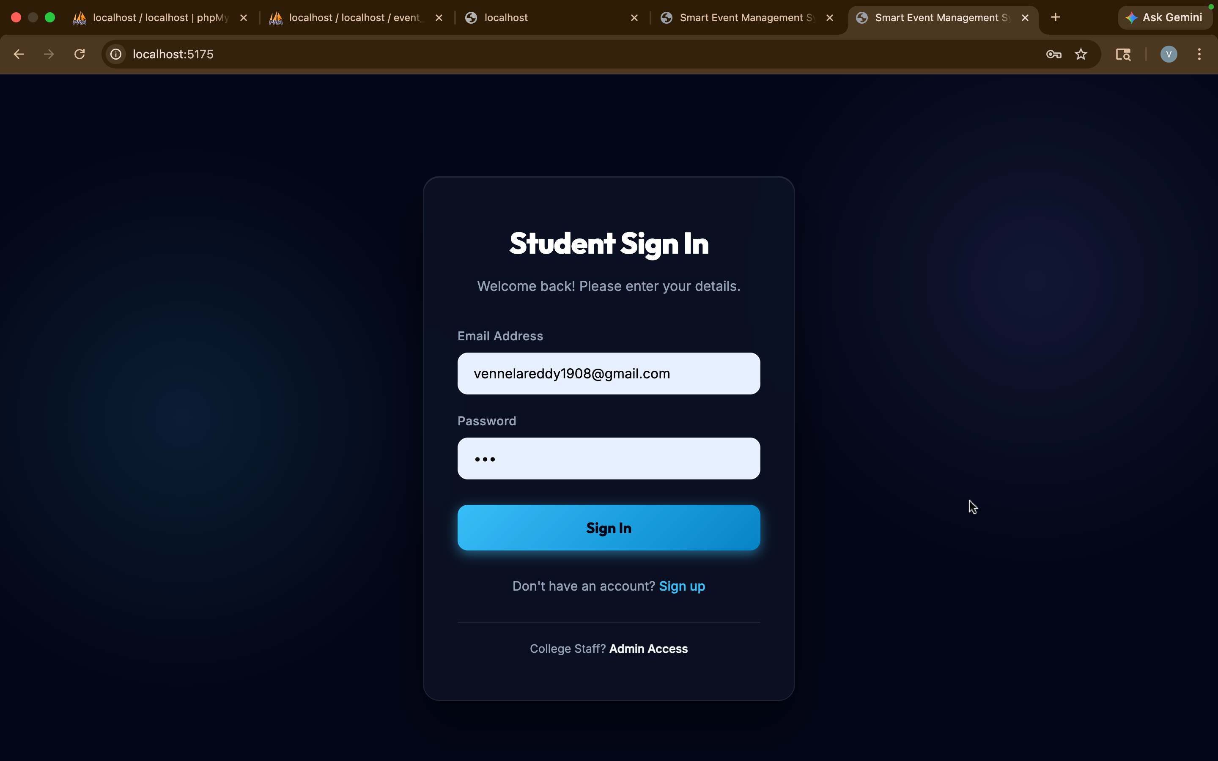
IMPLEMENTATION SCREENSHOTS
1
2
3
4
5
6
7
8
9

Slide 11
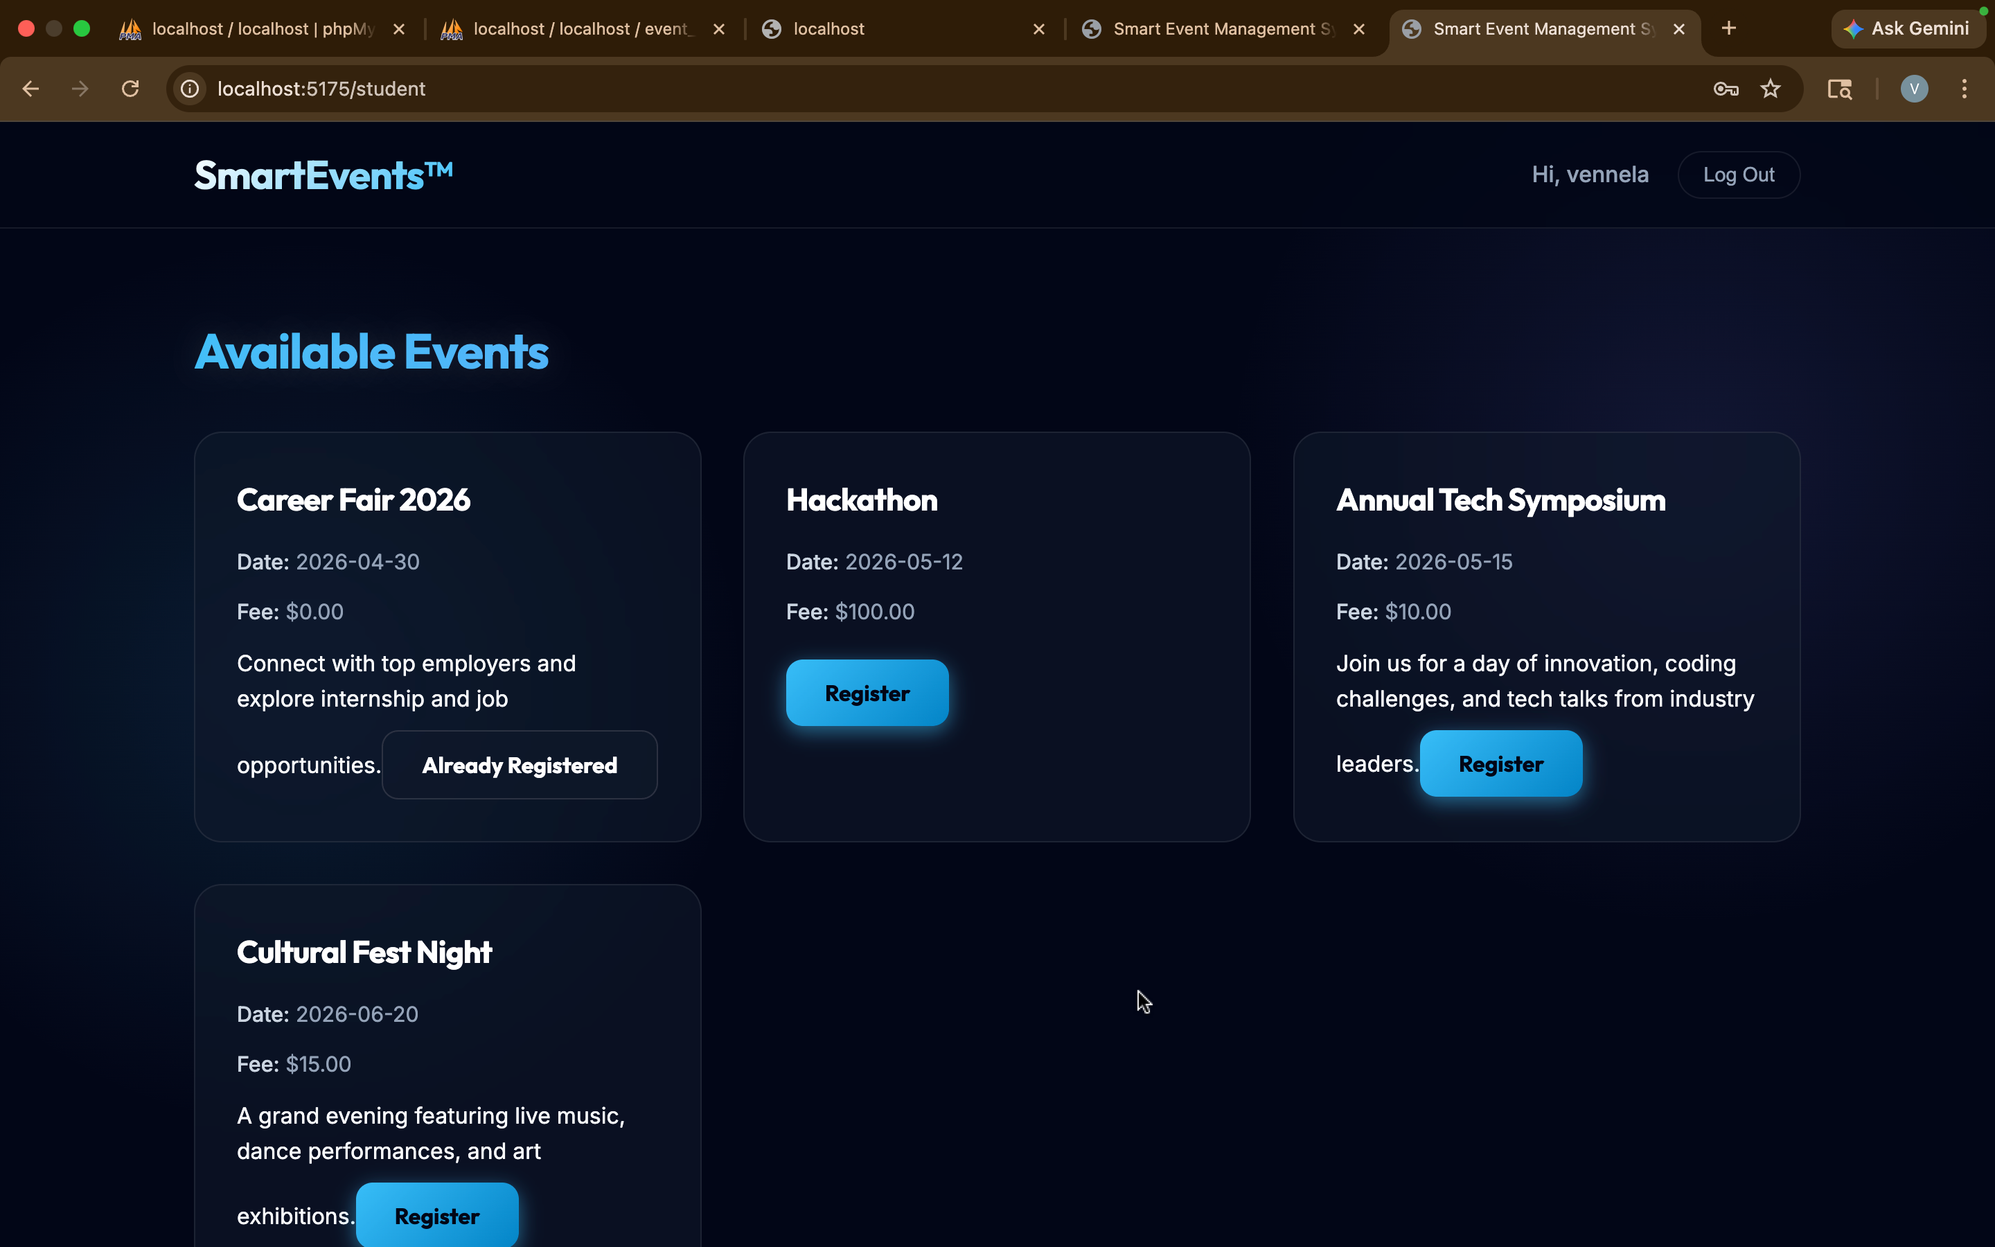
IMPLEMENTATION SCREENSHOTS
1
2
3
4
5
6
7
8(A)
9

Slide 12
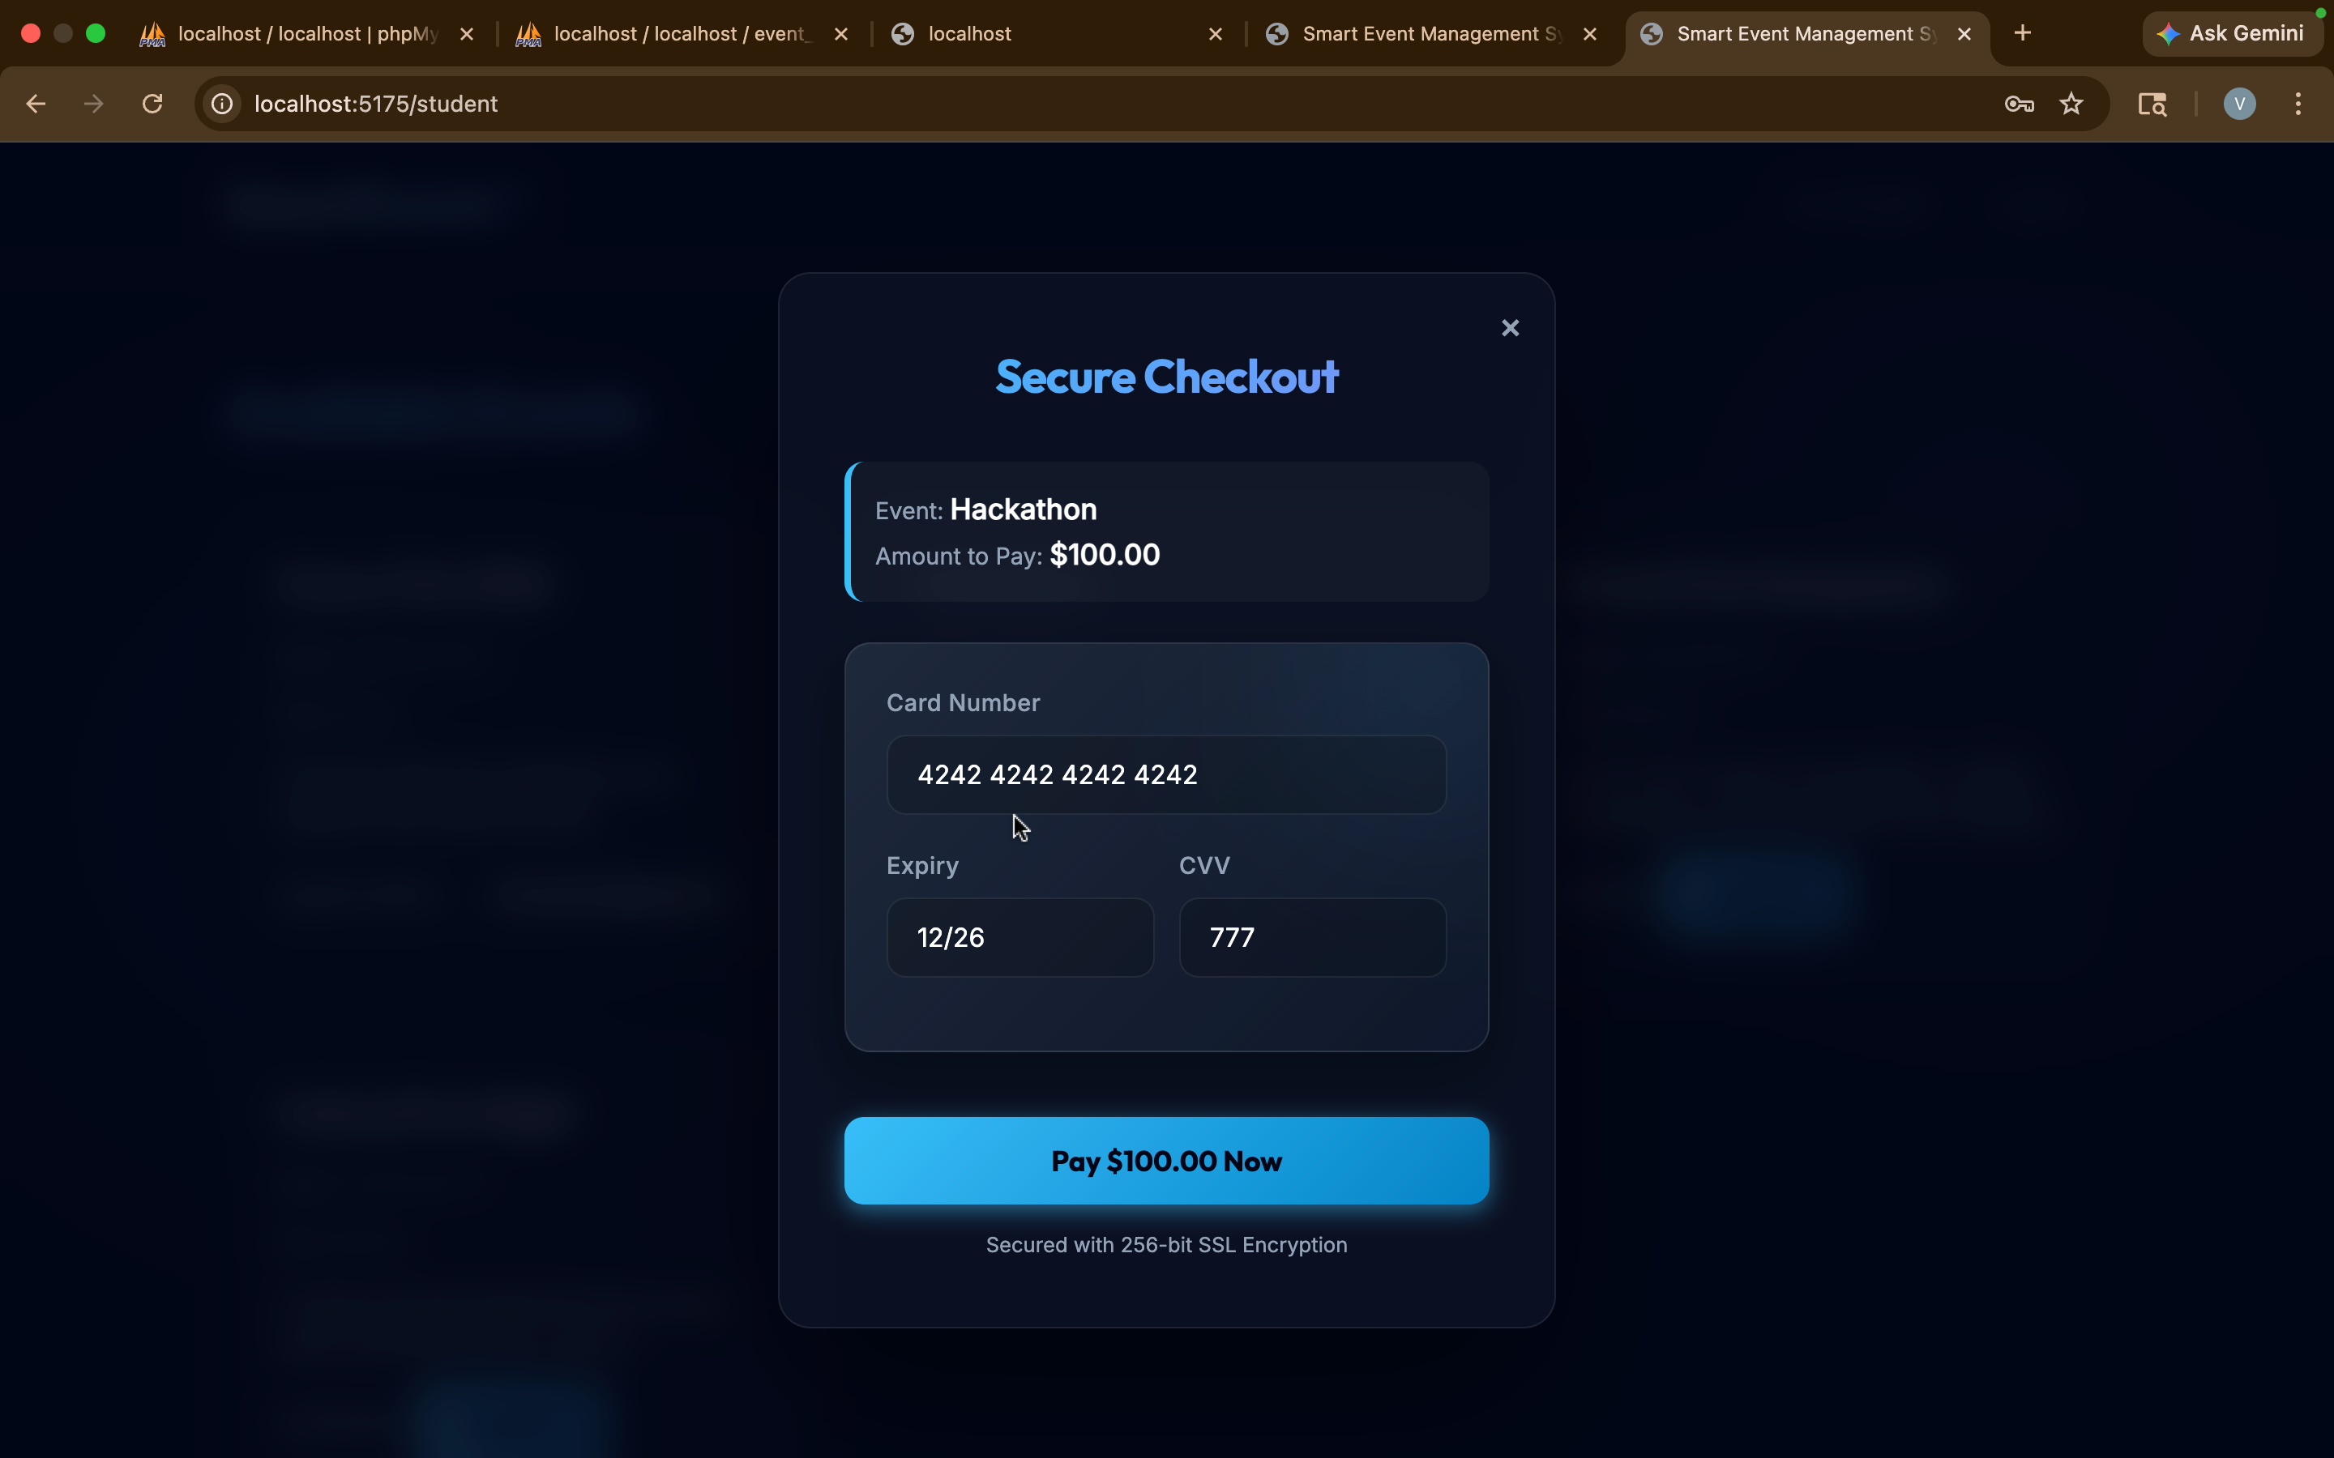
IMPLEMENTATION SCREENSHOTS
1
2
3
4
5
6
7
8(B)
9

Slide 13
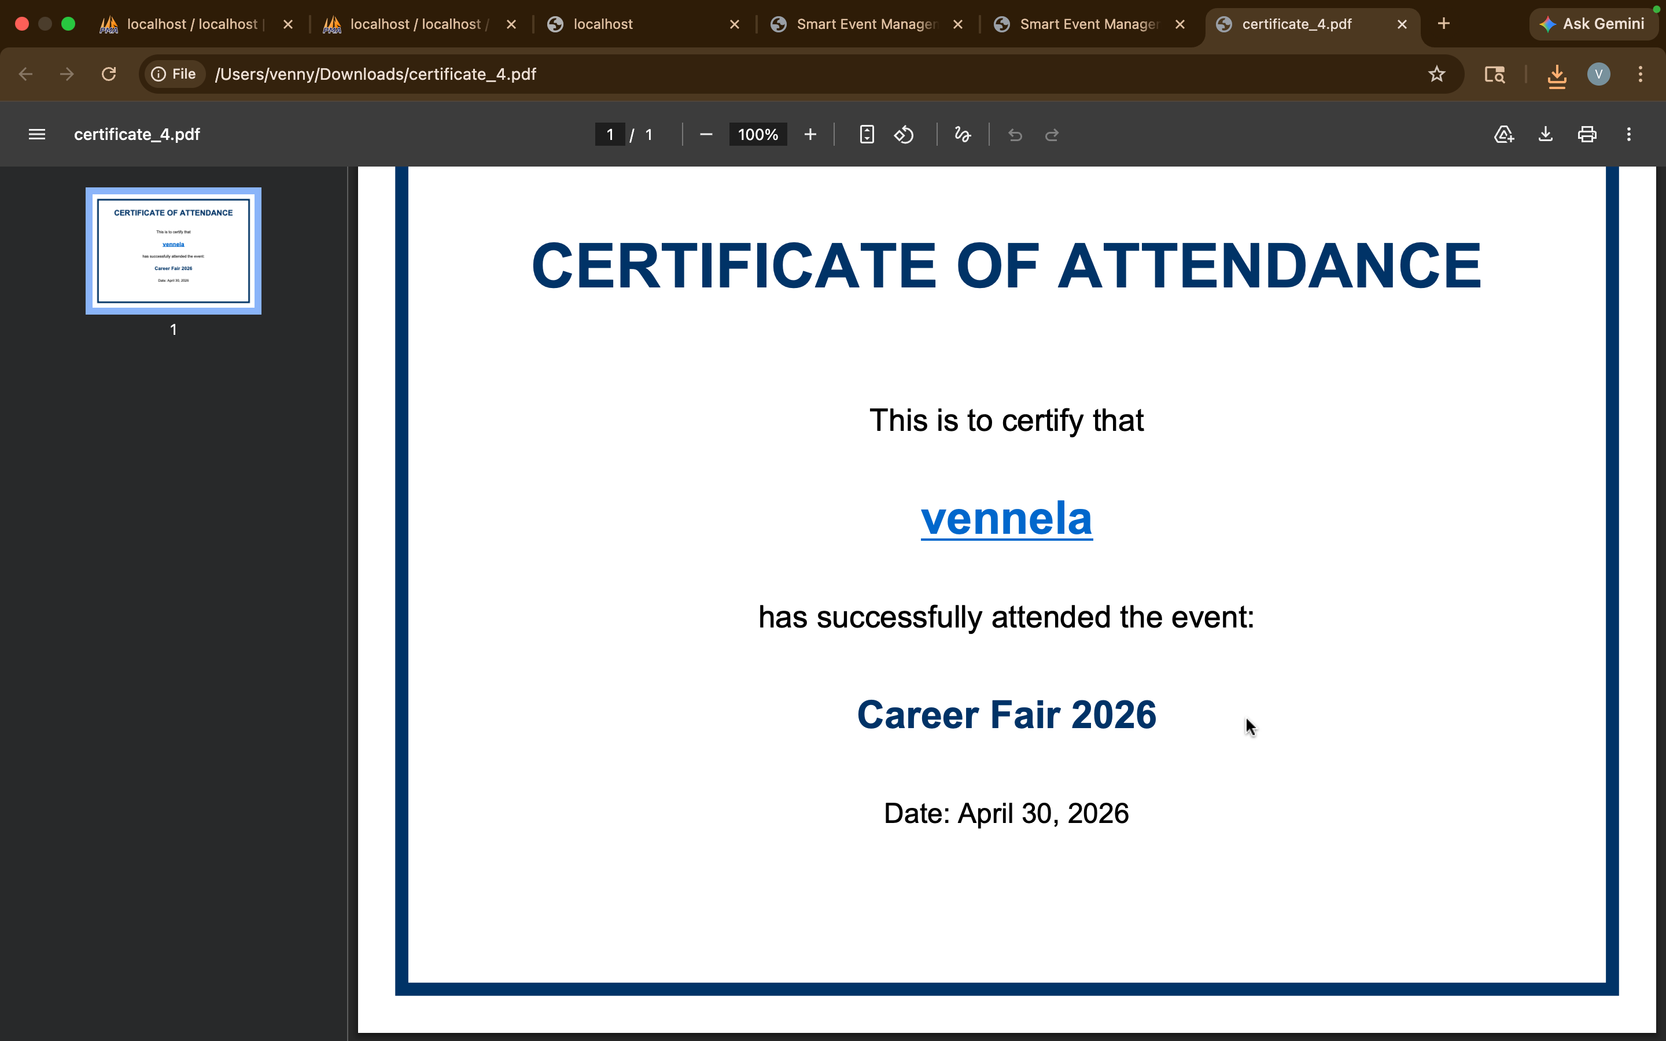
IMPLEMENTATION SCREENSHOTS
1
2
3
4
5
6
7
8(C)
9

Slide 14
ADVANTAGES & LIMITATIONS
Advantages:
Centralized platform for managing all event-related activities
Reduces manual work and paperwork
Easy and quick online registration and payment process
Accurate attendance tracking with minimal errors
Automatic certificate generation, saving time
Improves transparency between students and admin
User-friendly interface for better experience
Disadvantages:
Requires internet connectivity to access the system
Initial setup and development cost can be high
Dependency on system reliability (server downtime issues)
Requires basic technical knowledge for admin usage
Security risks if proper data protection is not implemented
1
2
3
4
5
6
7
8
9

Slide 15
Thank you

